Slide 1
AKSHAI KRISHNA A
WEATHER PREDICTION SYSTEM USING DEEP LEARNING
REG NO: 211521104007
NAN MUTHALVAN ID: au211521104007
3/21/2024 Annual Review

Slide 2
WEATHER PREDICTION SYSTEM USING DEEP LEARNING
RNN enhances weather prediction precision.
Implements recurrent neural network for forecasting.
Utilizes historical data for RNN training.
Improves accuracy across diverse weather conditions.
Employs RNN to streamline forecasting methodologies.
Enhances preparedness in agriculture, transportation, and disaster management.
Advances traditional forecasting techniques with RNN innovation.
3/21/2024 Annual Review

Slide 3


AGENDA
Introduction to Weather Prediction System.
Overview of Recurrent Neural Networks (RNN).
Data Preprocessing Techniques.
Architecture of RNN for Weather Forecasting.
Training and Validation Processes.
Evaluation Metrics and Performance Analysis.
Future Directions and Conclusion.
3/21/2024 Annual Review

Slide 4

PROBLEM STATEMENT
Inaccurate weather forecasts pose significant challenges to planning and decision-making processes across various sectors. Traditional forecasting methods often lack the precision needed to capture complex weather patterns effectively. These methods struggle to handle dynamic weather data and adequately model temporal dependencies. As such, there is a pressing need for a robust and accurate weather prediction system that can leverage advanced technologies to overcome these limitations. The objective is to develop a deep learning solution capable of providing precise weather forecasts, thereby enhancing preparedness and decision-making in sectors such as agriculture, transportation, and disaster management.
3/21/2024 Annual Review

Slide 5

PROJECT OVERVIEW
Utilizes deep learning for accurate weather forecasting.
Focuses on Recurrent Neural Networks (RNN) for modeling weather data.
Leverages historical weather data for RNN training.
Aims to improve forecasting accuracy and reliability.
Enhances preparedness and decision-making in various sectors.
Addresses limitations of traditional forecasting methods with advanced technology.
Strives to revolutionize weather prediction methodologies for better outcomes.
3/21/2024 Annual Review

Slide 6

WHO ARE THE END USERS?
Agricultural sector for crop planning and irrigation management.
Transportation industry for route optimization and scheduling.
Energy sector for demand forecasting and resource allocation.
Disaster management agencies for early warning systems and evacuation planning.
Aviation industry for flight planning and safety measures.
Outdoor event organizers for scheduling and contingency planning.
General public for everyday planning and safety precautions.
3/21/2024 Annual Review

Slide 7

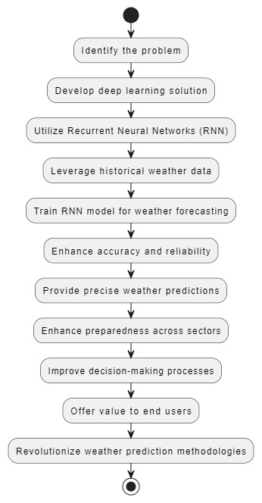
YOUR SOLUTION AND ITS VALUE PROPOSITION
3/21/2024 Annual Review

Slide 8

THE WOW IN YOUR SOLUTION
Precision: Achieve remarkably accurate weather forecasts.
Reliability: Provide consistent and reliable predictions over time.
Adaptability: Seamlessly handle various weather patterns and conditions.
Efficiency: Streamline decision-making processes with timely insights.
Versatility: Serve diverse end users across multiple sectors effectively.
Innovation: Harness advanced deep learning technology for forecasting.
Impact: Revolutionize traditional forecasting methodologies for better outcomes.
3/21/2024 Annual Review
8

Slide 9
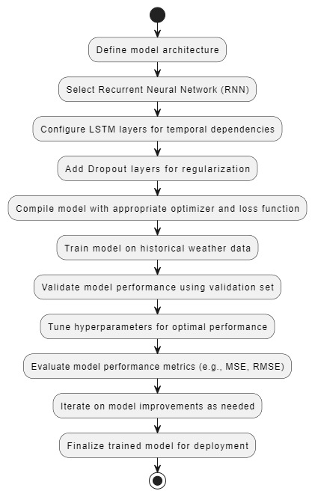
MODELLING
3/21/2024 Annual Review
9

Slide 10
RESULTS
Trained model on historical weather data.
Validated performance using a separate validation set.
Evaluated model using metrics such as MSE and RMSE.
Visualized actual vs. predicted weather data for analysis.
Analyzed accuracy and reliability of predictions achieved.
Compared results with traditional forecasting methods.
Highlighted improvements attained through deep learning.
Demo Link
3/21/2024 Annual Review
10

